Slide 1
Give me some credit-Kaggle
Lending money entails risk, and your credit rating tells prospective lenders how reliable or unreliable you are at repaying loans
Credit score determines what sort of terms you are likely to get.
Financial distress will affect the individual’s credit score
Model for an individual to experience distress in the next two years
Aim: Apply xgboost regression model to find the probability of the distress in the individual’s account

Slide 2
Data
SeriousDlqin2yrs -Person experienced 90 days past due delinquency or worse
Revolving Utilization Of Unsecured Lines –(Total balance on credit cards and personal lines of credit except real estate and no installment debt like car loans)/ sum of credit limits . (Balance to credit ratio)
Age - Age of borrower in years
Number Of Time 30-59 Days Past Due Not Worse -Number of times borrower has been 30-59 days past due but no worse in the last 2 years.
DebtRatio – (Monthly debt payments, alimony,living costs) /monthy gross income
MonthlyIncome
NumberOfOpenCreditLinesAndLoans -Number of Open loans (installment like car loan or mortgage) and Lines of credit (e.g. credit cards)
NumberOfTimes90DaysLate -Number of times borrower has been 90 days or more past due.
NumberRealEstateLoansOrLines -Number of mortgage and real estate loans including home equity lines of credit
NumberOfTime60-89DaysPastDueNotWorse -Number of times borrower has been 60-89 days past due but no worse in the last 2 years.
NumberOfDependents -Number of dependents in family excluding themselves (spouse, children etc.)
Training data size =(150000,12)

Slide 3
Approach
Data exploration and visualization
Finding delinquents distribution
Find if data is skewed (normally distributed data is better to fit in the model)- right skewed
Finding missing values- monthly income and NumberOfDependents
Identify outliers- DebtRatio, Revolving Utilization Of Unsecured Lines, NumberOfTimes90DaysLate, Number Of Time 30-59 Days Past Due Not Worse , NumberOfTime60-89DaysPastDueNotWorse

Slide 4
DATA PRE-PROCESSING
Monthly income and number with dependents – Nan value replaced with median.
Log transformation of data .
Debt ratio- values ==0 and value>2 was dropped (ratio)
NumberOfTimes90DaysLate, Number Of Time 30-59 Days Past Due Not Worse , NumberOfTime60-89DaysPastDueNotWorse - value==96 and value==98 had a value count of 264 and 5 respectively which was considered to be outlier and hence value >20 were replaced with median
Revolving Utilization Of Unsecured Lines - value==0 was dropped and value>1 were replaced with median.
Training set (139121,15)

Slide 5
FEATURE ENGINEERING
Per person income= monthly income/(number of dependents+1)
Late frequency= (Number Of Time 30-59 Days Past Due Not Worse) + (NumberOfTimes90DaysLate) + (NumberOfTime60-89DaysPastDueNotWorse)
Monthly debt= debt ratio* monthly income
Monthly balance= Monthly income – Monthly debt
Number of open credit lines= Number of open credit loans and lines- number of real estate loans
Training set(139121,17)

Slide 6
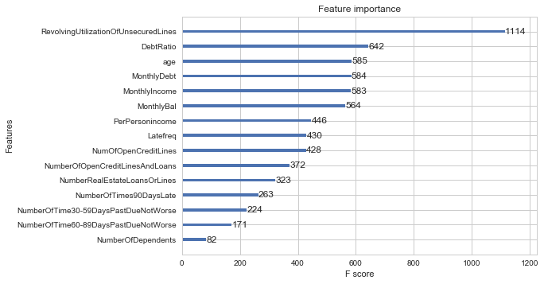
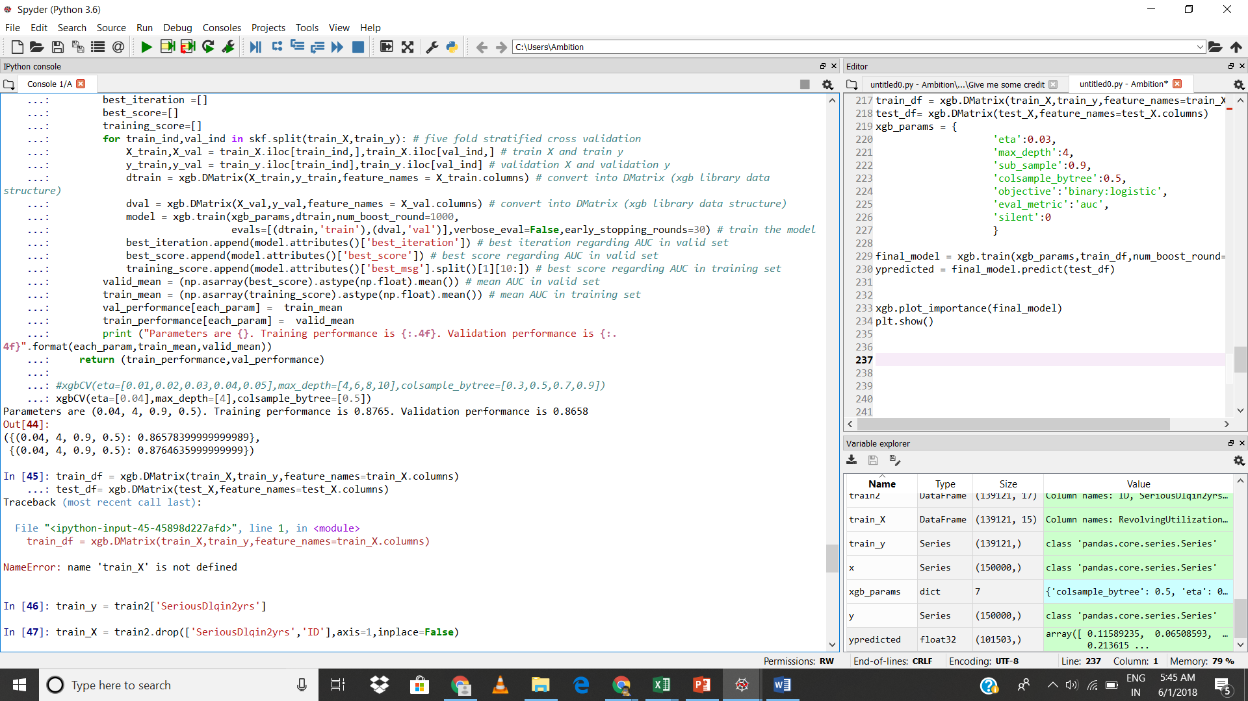
Applying XGBoost model
Probability of test set was found using this model along with the feature importance , the training performance of .8765 and validation performance of 0.8658

Slide 7
THANK YOU FOR THE RICH LEARNING EXPERIENCE.

